Slide 1
WHAT IS AGILE?
A Framework centered on two main principles.
Active communication between Team and Users.
Iterative, Incremental, Continuous Delivery.
Flexible Approach to Development.
Does not require full-fledged analysis at outset.
Work be broken down into small iterations, each a complete deliverable to client.

Slide 2
AGILE MANIFESTO
A Statement of Values
Individuals and interactions over processes and tools
Working software over comprehensive documentation
Customer collaboration over contract negotiation
Responding to change over following a plan
http://www.agilemanifesto.org

Slide 3
DIFFERENT AGILE METHODS
Extreme Programming(XP).
Scrum.
Agile Modeling.
Adaptive Software Development(ASD).
Crystal Clear and other Crystal Methodologies.
Dynamic System Development Methods(DSDM).
Feature Driven Development.
Lean Software Development.
Agile Unified Process.

Slide 4
WHAT IS SCRUM ? …
Scrum is a Project Management Process.
Scrum is an “Agile” process.
Scrum contrasts itself with Waterfall method of Software Development.
Scrum can be used to manage all kinds of Projects.
Scrum focuses more on people and communication as against process and documentation.
Scrum requires just “adequate” analysis to get started – don’t seek Perfection at start.

Slide 5
WHAT IS SCRUM ?
Scrum is an Iterative process
Scrum asks for Incremental development of the Product or Solution
Scrum involves a cross-functional team (e.g. Development, Testing, Documentation) working at the same time (as against Waterfall)
Scrum has the cross-functional team working in short development bursts called “Sprints” to regularly produce complete increment of product
Scrum exposes risks, benefits, opportunities

Slide 6
WHAT IS NOT SCRUM ?
Scrum is not a rigid methodology – it’s a simple process framework that organizations can adapt according to their own environment
Scrum is not for managing Software Projects only. It’s a general Project Management framework.
Scrum is not anti-Documentation or anti-Analysis

Slide 7
MOTIVATION FOR SCRUM
Traditional Software Management is failing
<☹☹☹>
We have slipped schedules, lower quality, unhappy clients, dissatisfied team
</☹☹☹>
Waterfall do not expose risks and opportunities early on.
Traditional practices fail in case of complex projects (time or functionality)

Slide 8
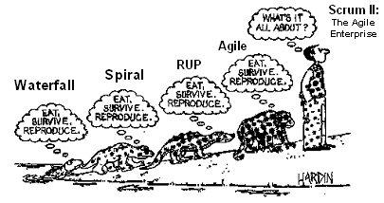
EVOLUTION ….

Slide 9
WHEN SCRUM CAN BE APPLIED?
Complex Projects.
Project with changing requirements.
Project with changing environment and conditions.
Project with uncertainties.
Project where all analysis (requirements, schedules, resource allocation) can not be done at the start (or at least not accurately).
<number>

Slide 10
SCRUM PROCESS … OUTLINE
Start with Vision of what you want to achieve.
Come up with Core Requirements and priorities (Bare Minimum but good enough to get started) – Product Backlog
Team selects the requirements that it can implement in the first iteration (Planning Meeting)
Team defines tasks for completing requirements (Sprint Backlog)
Team goes in 30-Day Development Cycle (Sprint)
Team meets daily to sync up on progress (Daily Scrum)
Team goes through the complete process (design, development, testing, documentation) to complete an increment of functionality.
At the end of 30 day sprint, Team demonstrates completed functionality to bosses and stakeholders (Sprint Review)
Team analyses its Sprint performance (Sprint Retrospective)
Requirements are prioritized, redefined.
Team goes through the process again (Sprint 2, Sprint 3, …, Release)

Slide 11
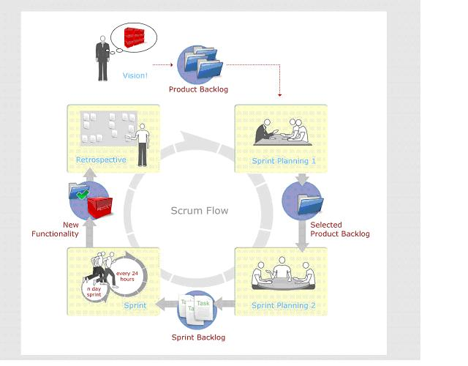
SCRUM PROCESS – VISUALLY

Slide 12
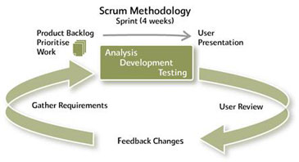
SCRUM PROCESS – ANOTHER ANGLE

Slide 13
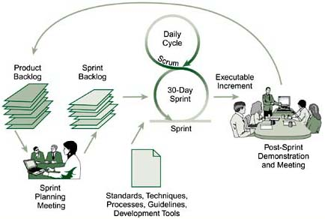
SCRUM PROCESS – YET ANOTHER ANGLE

Slide 14
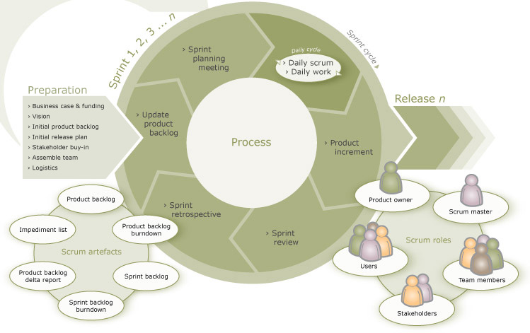
A COMPLETE VIEW

Slide 15
THE COMMITTED PEOPLE
There are 3 roles of the people who have committed themselves to the success of Scrum and are ultimately responsible for it.
Product Owner
Responsible for defining requirements of the project and their priorities.
The Team
The Cross-Functional Team that works on the Requirements defined and in the priority as given by the Product Owner. The Team is what carries out the Sprint.
Scrum Master
Member of Team that drives the Scrum. He guides the team and makes sure that Scrum is implemented.

Slide 16
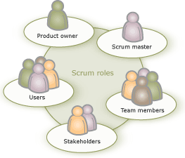
ROLES ….

Slide 17
SCRUM MASTER …
Responsible for running the Scrum.
Plays the role of a facilitator, guider, trainer, motivator, impediment remover.
Scrum Master is NOT exactly Project Manager.
Should know more about the Scrum process than others.
Should be very clear on the philosophy behind Scrum principles.
Responsible for improving the overall working environment and conditions for the team.
Makes sure that the team is not obstructed in any way during the Sprint.
Ensures Scrum principles are followed.

Slide 18
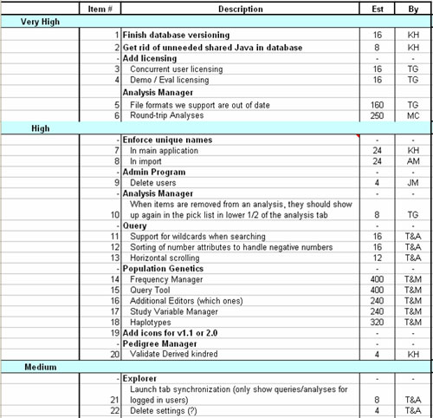
PRODUCT BACKLOG …

Slide 19
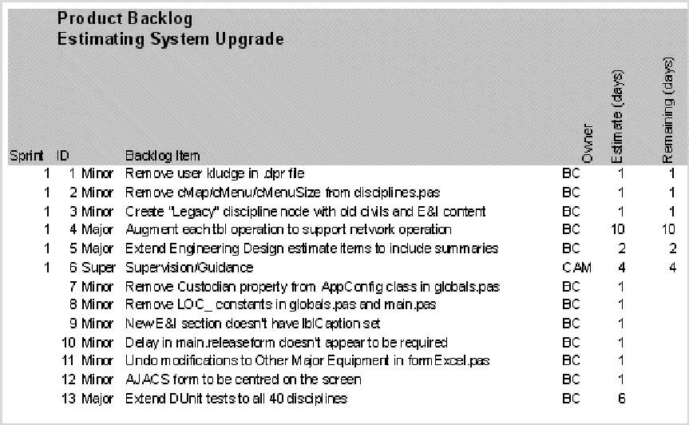
PRODUCT BACKLOG …

Slide 20
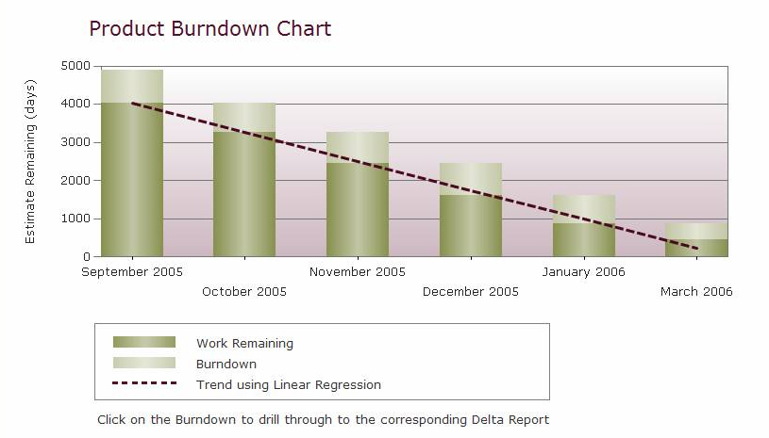
PRODUCT BURNDOWN GRAPH

Slide 21
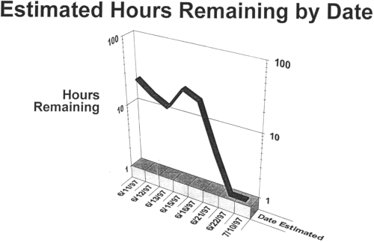
SPRINT BURN DOWN GRAPH

Slide 22
SPRINT REVIEW
Conducted at the end of Sprint
Team demonstrates completed functionality in Sprint to Product Owner and Stakeholders
It’s the ‘inspection and adaptation’ part
Management can identify risks and opportunities
Product Owner and others can reprioritize the Product Backlog after this ‘feedback’

Slide 23
SPRINT REVIEW RULES
Team should not spend more than 1 hour to prepare
Only ‘done’ functionality is presented
Sprint Review involves team presenting functionality, answering questions and discussion
Everyone gives their feedback
Scrum Master schedules and conducts the meeting

Slide 24
SPRINT RETROSPECTIVE
Conducted after Sprint Review by the Team
They evaluate the just concluded Sprint
They discuss what went wrong, what went right and what needs to be changed and improved
The objective is to ensure that the next Sprint goes better than the current Sprint

Slide 25
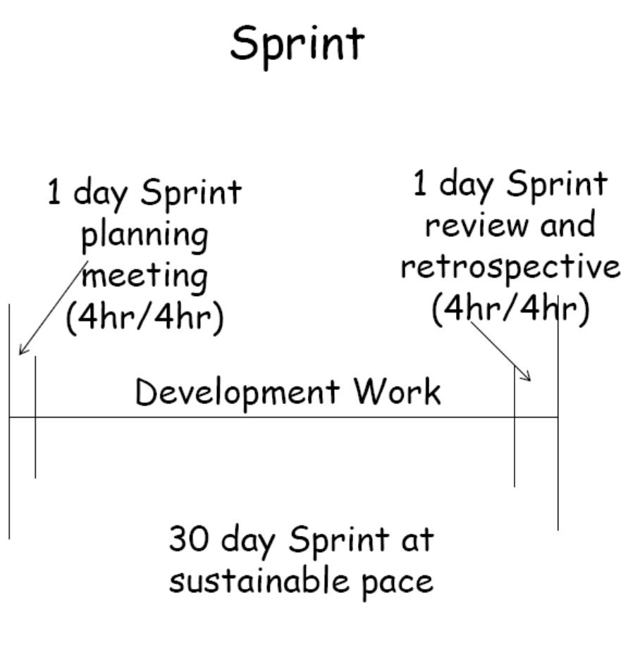
SCRUM PROCESS - MEETINGS

Slide 26
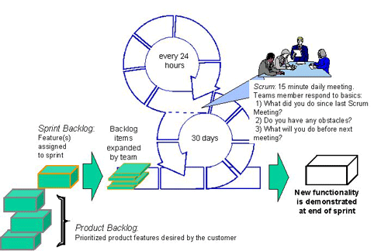
DAILY SCRUM MEETING

Slide 27
DAILY SCRUM – RULES
Chickens can attend – but cannot interfere
Every Team members answers 3 questions:
What has he done since last meeting?
What he plans to do between now and next meeting?
What impedes his work progress?
There should be no digressing beyond these 3 questions

Slide 28
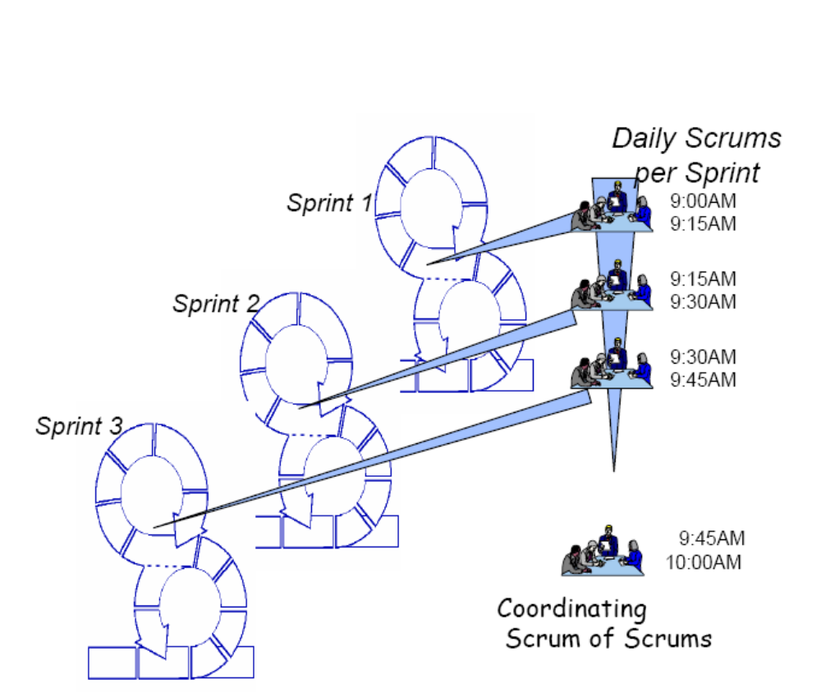
SCRUM OF SCRUMS …

Slide 29
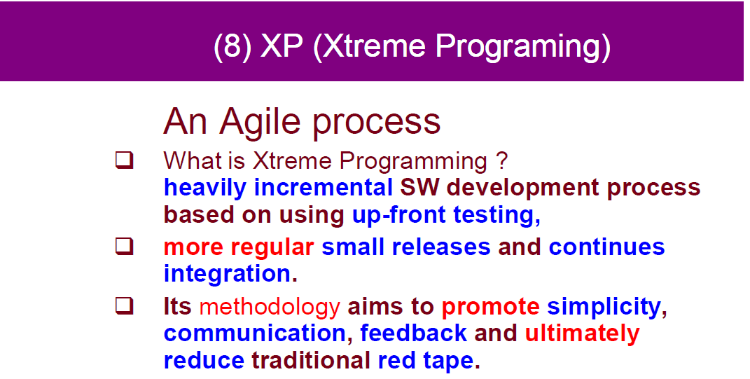


Slide 30
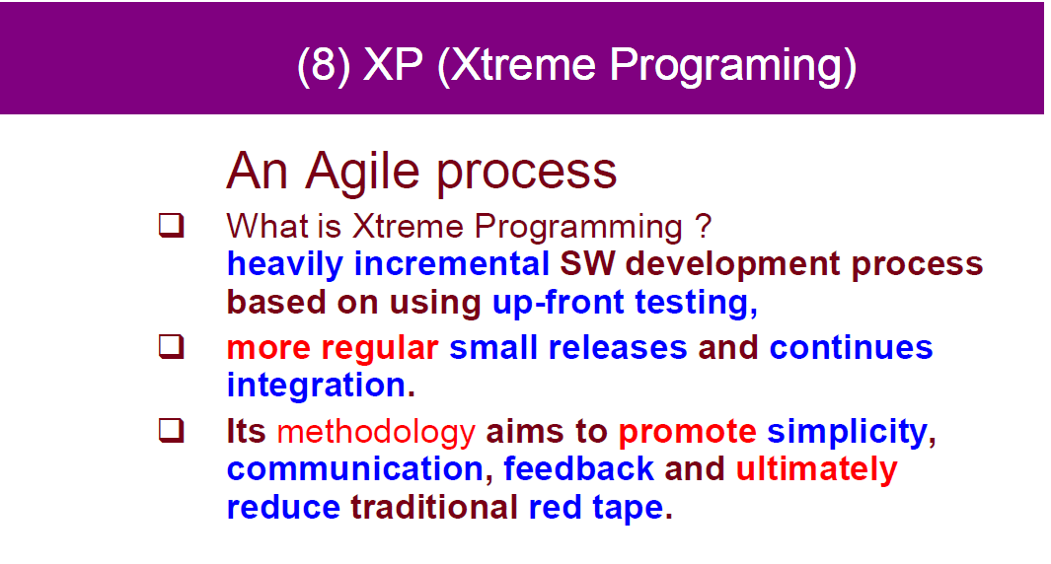

Slide 31
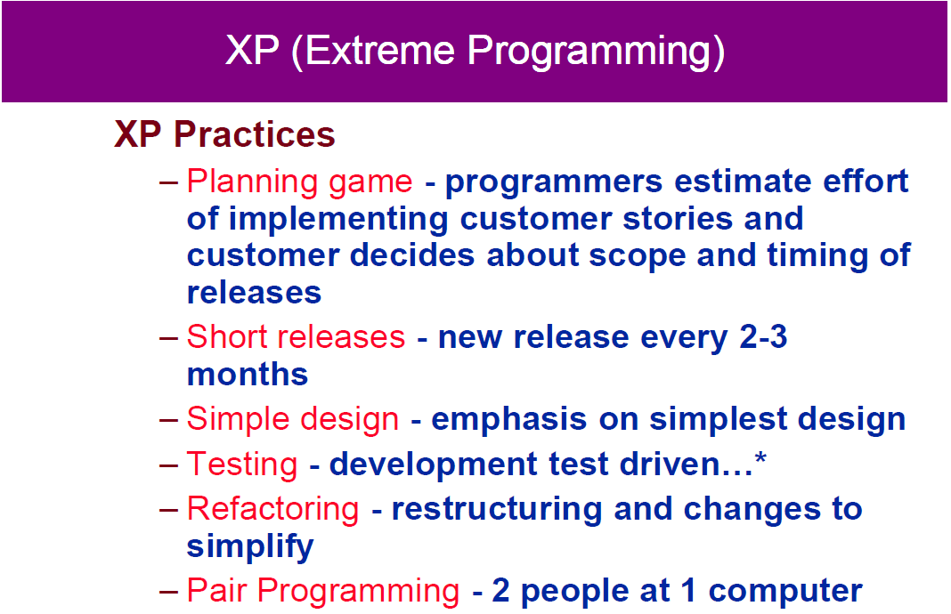

Slide 32
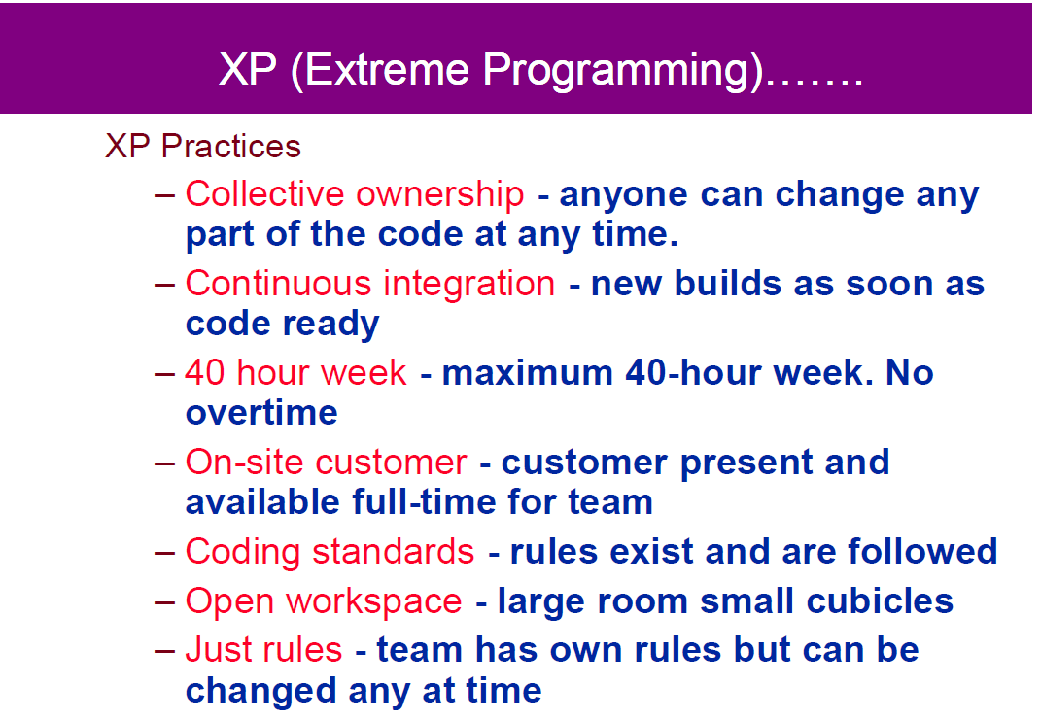

Slide 33
